Slide 1
Paying for an education beyond high school
Notes:
This next segment is about Paying for College. We’ll share the different financial aid resources available.

Slide 2
Lloyd Mueller
Director of Financial Aid
Clatsop Community College
lmueller@clatsopcc.edu
503-338-2412

Slide 3
Topics We Will Discuss Tonight
What is financial aid
Cost of attendance (COA)
Expected Family Contribution (EFC)
Financial need
Categories, types, and sources of financial aid
Free Application for Federal Student Aid (FAFSA) and the financial aid award
Special circumstances

Slide 4
What is Financial Aid?
Financial aid consists of all funds provided to students and families to help pay for postsecondary educational expenses

Slide 5
What is Cost of Attendance (COA)
Direct costs – Tuition, fees, and on campus housing
Indirect costs – Books, supplies, transportation, personal expenses
Direct and indirect costs combined into COA, cost of attendance
Varies widely from college to college

Slide 6
Typical yearly college costs
Clatsop Community College $4,995/$12,291 (living at home)
University of Oregon $9,918/$24,405 (living in dorm)
University of Portland $38,520/$52,584 (living in dorm)
2014-15 costs based on 15 credits per term/semester
Notes:
Which college would cost you the most to attend? Based on the price alone the answer may seem obvious with the example of the private and state colleges. However, it isn’t as simple as comparing these numbers.

Slide 7
What is the Expected Family Contribution (EFC)
Amount family can reasonably be expected to contribute to the educational process
Stays the same regardless of college
Two components
Parent contribution
Student contribution
Calculated using data from a federal application form and a federal formula

Slide 8
What is Financial Need
Cost of Attendance
– Expected Family Contribution
= Financial Need

Slide 9
Categories of Financial Aid
Need-based
Non-need-based

Slide 10
Types of Financial Aid
Scholarships
Grants
Loans
Employment

Slide 11
Scholarships
Money that does not have to be paid back
Awarded on the basis of merit, skill, or unique characteristic

Slide 12
Grants
Money that does not have to be paid back
Usually awarded on the basis of financial need

Slide 13
Loans
Money students and parents borrow to help pay college expenses
Repayment usually begins after education is finished
Only borrow what is really needed
Look at loans as an investment in the future

Slide 14
Employment
Allows student to earn money to help pay educational costs
A paycheck
Non-monetary compensation, such as room and board

Slide 15
Sources of Financial Aid
Federal government
States
Private sources including colleges
Civic organizations and churches
Employers

Slide 16
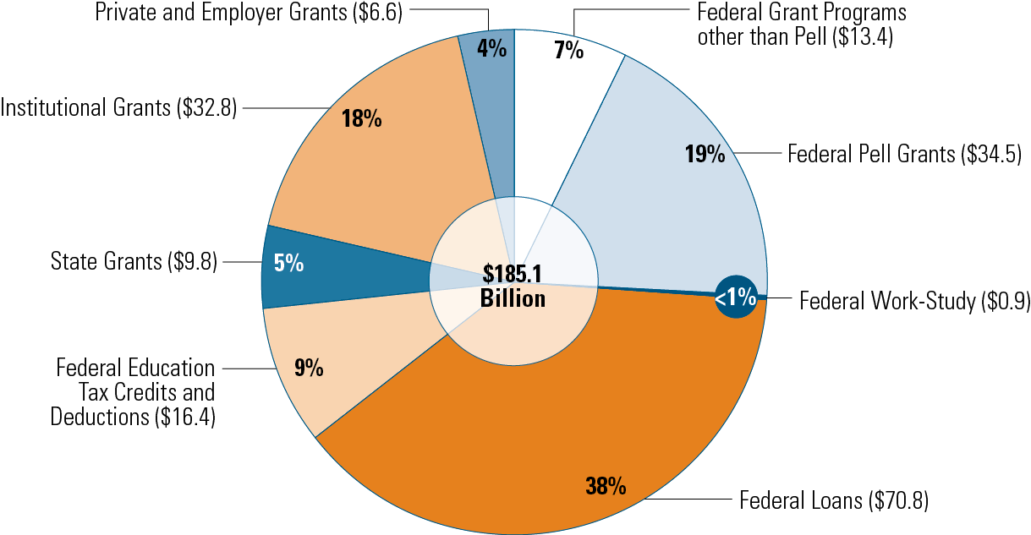
Undergraduate Student Aid (in Billions), 2013-14
SOURCE: The College Board, Trends in Student Aid 2014, Figure 2A.

Slide 17
Federal Government
Largest source of student financial aid
Awarded primarily on the basis of financial need
Must apply every year using the Free Application for Federal Student Aid (FAFSA)

Slide 18
Types of Federal financial aid
Need-based federal aid
Non-Need-based federal aid
Pell Grant
SEOG
Work-Study
Perkins Loan
Subsidized Direct Loan
Unsubsidized Direct Loan
PLUS Loan
TEACH Grant
Notes:
There are several federal financial aid programs. It is important to note a couple of things: (1) some are based on you demonstrating need, but others are available even if you do not demonstrate need, and (2) you have to file a FAFSA to be considered for all these programs.
The details about these programs are contained in the Opportunities booklets, so you should take some time at home to see just how much money might be available for you to attend college.

Slide 19
Oregon state grant program
The Oregon Opportunity Grant is available by filling out the FAFSA – no additional application needed
Must be an Oregon resident attending an approved Oregon college
File the FAFSA by February 1 to be
considered
Notes:
The Oregon Opportunity Grant is available by completing the FASFA. In order to receive the grant you must be an Oregon resident attending an approved college. Approved colleges include the 40+ public and private colleges and community colleges with in Oregon. To be considered for the grant you must complete and file the FASFA by February 1. This is the final deadline but it’s best to submit your FAFSA early because funds will run out.

Slide 20
Oregon state grant program
Estimated family income to qualify for Oregon Opportunity Grant is $70,000
Maximum 2015-2016 award is $2,000
Students will be notified of award by OSAC email and by their college of choice
You can receive the grant for four years of full-time enrollment
Notes:
The maximum family income to qualify is $70,000. The maximum amount of the award is expected to be $2,000 and if you are eligible, you can receive it for four years of full-time enrollment, not including the summer term, at any Oregon public or non-profit private college. Awards are prorated for half-time enrollment.

Slide 21
Private Sources/colleges
Colleges are a large source of financial aid. Scholarships, grants, loans, and employment
Foundations, businesses, charitable organizations
Deadlines and application procedures vary widely
Begin researching private aid sources early

Slide 22
Civic Organizations and Churches
Research what is available in community
What community organizations and churches does your family belong?
Application process usually spring of senior year
Small scholarships add up!

Slide 23
Employers
Companies may have scholarships available to the children of employees
Companies may have educational benefits for their employees

Slide 24
Free Application for Federal Student Aid (FAFSA)
A standard form that collects demographic and financial information about the student and family
May be filed electronically or using paper form

Slide 25
FAFSA
The first F in "FAFSA" stands for "free!“
There are websites at which students can get help filing the FAFSA for a fee. These sites are not affiliated with or endorsed by the U.S. Department of Education (ED). Avoid these sites and not to pay these sites for assistance that is provided for free at ED's website or through the college you are interested in.

Slide 27
About the FAFSA
Three versions of the FAFSA
Online – www.fafsa.gov
PDF FAFSA – Print from your computer
Paper FAFSA – Call 800.4.FED.AID
It is always free to complete the FASFA
Online version is best
Built-in edits make it easier to complete accurately
Sign it electronically
Faster processing results
Notes:
You only have to fill out one version of the FAFSA, but you can choose which version works best for you. You can begin preparations to file the FAFSA before January 1, but that is the earliest date you can file a FAFSA. You will also have to file a FAFSA each year you want to be considered for financial aid.
Be careful of the web address you enter. There is a web site – www.fafsa.com – that will charge you $80 to help you file the FAFSA. The free site is www.fafsa.gov.
Most people choose the online version because it has built in edits which help improve the accuracy of your FASFA. You can sign your FASFA electronically by obtaining a PIN (Personal Identification Number) from www.pin.ed.gov. The benefit of filing online is it’s easier and you‘ll get faster results.

Slide 28
About the FAFSA
FAFSA = Free Application for Federal Student Aid
Determines eligibility for
Most federal financial aid programs
Many state financial aid programs
Much of the aid colleges award from their own funds
Some scholarship programs
Colleges may require additional forms to collect more detailed data
Notes:
The way to access most federal and state financial aid is by filling out the Free Application for Federal Student Aid (FAFSA). By filling out the FAFSA you will be considered for eligibility for the many financial aid programs. You’ll also be considered for some of the state and private grants and institutional aid the college may offer. Some private colleges may have more private grant money available than state colleges.
Some colleges will ask you to complete a form that asked for more detailed financial information.
Remember, you will need to complete a FAFSA each year in which you wish to be considered for financial aid.

Slide 29
FAFSA
Information used to calculate the Expected Family Contribution or EFC
The amount of money a student and his or her family may reasonably be expected to contribute towards the cost of the student’s education for an academic year
Colleges use EFC to award financial aid

Slide 30
About the FAFSA
FAFSA asks you questions about
Income
Assets
Family size
Number of family members attending college
Number one reason people don’t file a FAFSA
They assume they are not eligible for aid
This may be a costly assumption
Notes:
The FAFSA asks you a lot of questions about your personal financial situation such as your family income, assets, family size and number of family members attending college. The goal of the FAFSA is to determine how much financial aid you need and whether you are eligible to receive federal aid.
The primary reason people do not file the FAFSA is that they assume they will not be eligible to receive any aid. That might be a costly mistake.

Slide 31
FAFSA
May be filed at any time during an academic year, but no earlier than the January 1st prior to the academic year for which the student requests aid
For the 2015–16 academic year, the FAFSA may be filed beginning January 1, 2015
Colleges may set their own FAFSA filing deadlines

Slide 32
FAFSA on the Web
Website: www.fafsa.gov
2015–16 FAFSA on the Web available on January 1, 2015
FAFSA on the Web Worksheet:
Used as “pre-application” worksheet
Questions follow order of FAFSA on the Web

Slide 33
FAFSA on the Web
Built-in edits to prevent costly errors
Skip logic allows student and/or parent to skip unnecessary questions
Option to use Internal Revenue Service (IRS) data retrieval tool

Slide 34
FAFSA on the Web
More timely submission of original application and any necessary corrections
More detailed instructions and “help” for common questions
Ability to check application status on-line
Simplified application process in the future

Slide 35
IRS Data Retrieval
While completing the FAFSA, you may submit a real-time request to the IRS for tax data
IRS will authenticate taxpayer’s identity
If match found, IRS shows real-time results to applicant
Applicant chooses whether or not to transfer data to the FAFSA

Slide 36
IRS Data Retrieval
Available early February 2015 for 2015–16 processing cycle
Participation is voluntary
Reduces documents requested by financial aid office

Slide 37
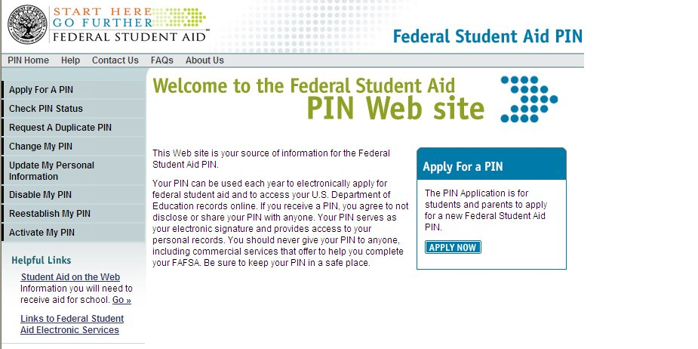
Federal Student Aid Personal Identification Number (FSA PIN)

Slide 38
Federal Student Aid Personal Identification Number (FSA PIN)
Website: www.pin.ed.gov
Sign FAFSA electronically
Not required, but speeds processing
May be used by students and parents throughout aid process, including subsequent school years

Slide 39
Frequent FAFSA Errors
Social Security Numbers
Divorced/remarried parental information
Income earned by parents/stepparents
Untaxed income
U.S. income taxes paid
Household size
Number of household members in college
Real estate and investment net worth

Slide 40
Tips for FAFSA success
Before completing the FAFSA
Download the FAFSA on the Web worksheet
Provides a preview of FAFSA questions
Gather documents for both parents and students
Income tax returns
W-2 forms and other income statements
Benefits records from state and federal agencies
Current bank statements
Notes:
Getting together the necessary paperwork for the FAFSA will save you time. You will need income tax returns (use last year’s if you’re estimating) and W-2 statements for parents and students. If you received unemployment or are receiving other state or federal assistance you will need the information about how much you received. Bank statements will help as well.
You‘ll use all of this information to fill out the FAFSA. Be sure to save a copy of the statements you used and print out a copy of your completed FASFA in case you need to refer to the information later.

Slide 41
Tips for FAFSA success
Meet all financial aid deadlines
Can vary from college to college
Meeting “priority deadline” results in best financial aid package based on your eligibility
It’s okay to estimate your financial information
Will have an opportunity to correct
List all colleges that you are applying to
Retain a copy of your completed FAFSA
Notes:
Do not miss any priority deadlines. If you miss the priority deadline, you still will get an award letter but it may not have all of the aid that you qualify for as there are limited amounts of grants available.
Signing the FAFSA is important and the number one mistake that students make is not to sign the paper version. The online version is signed with your PIN. Make sure that both you and your parents sign your FAFSA. Remember that your parents will need their own PIN to sign the FASFA.
List all the colleges that you’re applying to as well. To do this you will list each college’s name and address and their six digit federal school code. Find your colleges’ codes on the fafsa.ed.gov website.
Don’t delay in filling out your FAFSA. Go ahead and estimate your financial situation. You can correct it later.
Make a copy of your completed FAFSA for your records and store it in a secure place.

Slide 42
Signatures
Required
Student
One parent (dependent students)
Format
Electronic using PIN
Signature page
Paper FAFSA

Slide 43
FAFSA help is available
Online Help tools on www.fafsa.gov
Assistance is available at 1-800-4-FED-AID
Seaside H.S. is offering a FAFSA Night on Jan. 7th from 4-7
Notes:
When it comes to completing the FASFA you are not alone. There are many free resources for help. You can receive help at College Goal Oregon events on dates to be announced. (Do we want to add The College Place phone #?) Visit CollegeGoalOregon.org for more free help. You can also get help by phoneat 1-800-4-FED-AID.
At each location there will be financial aid administrators who will work with you individually to help you complete the FAFSA.

Slide 44
When the FAFSA’s done
After completing the FAFSA, the student receives the Student Aid Report (SAR)
Email or letter
Correct any errors and return
SAR contains Expected Family Contribution (EFC)
FAFSA information is also sent to the colleges you listed to receive the data
Notes:
Once you’ve finished your FAFSA you can expect your SAR in a few weeks – note that you’ll receive it quicker if you do the online version. Check it carefully for errors and return it. Your SAR will also list your Expected Family Contribution (EFC). It’s generally in the upper right hand corner with no decimal points. Your EFC is what the federal government estimates that you and your family can contribute to your college education.

Slide 45
Student Aid Report
Review data for accuracy
Update estimated information when actual figures are available

Slide 46
Making Corrections
If necessary, corrections to FAFSA data may be made by:
Using FAFSA on the Web (www.fafsa.gov) if student has a PIN;
Updating paper SAR; or
Submitting documentation to college’s financial aid office

Slide 47
The Financial Aid Award
COA (Cost of attendance) — EFC = financial need
The financial aid office at the school of your choice will determine eligibility for federal, state, and for any aid the college may be able to offer from its own funds
Financial aid office may ask for additional information
Student will receive an award letter
Notes:
Your EFC goes into determining the aid you are offered – also known as your award. Your EFC is the same no matter which college you’re applying to. Let’s say that you’re going to a college that has a cost of attendance of $20,000 and your expected family contribution is $6,000 annually. The college subtracts $6,000 from $20,000 and will try to offer an aid package of $14,000.
The financial aid office will take the cost of attendance and subtract your EFC and work to build a financial aid package that meets the leftover need. Depending on the college, the financial aid office may ask for additional information to help them in awarding you financial aid. Once your financial aid has been determined ,your financial aid office will send you an award letter with the details.

Slide 49
Understanding award letters
Read your award letter carefully
Could be either on paper or online
Follow instructions for next steps
Kinds and amounts of aid you are eligible for
Meet all deadlines on the letter
Notes:
Let’s talk about your award letter. Once you have been accepted for enrollment at any college, and have applied for financial aid by completing the Free Application for Federal Student Aid (FAFSA) and any other financial aid forms required by the college, you and your family will receive a financial aid award letter. This letter will detail the amount of financial support the college is able to provide for the upcoming year. You might receive the award letter along with your notice of acceptance. Some colleges make the award letters available online. Check with your colleges to see how they will distribute the award letters.
Read the fine print
• Read your award letter carefully to ensure you understand all terms and conditions so you can decide if you want to accept some, or all, of the aid offered.
• Look for instructions for your next steps. You might need to complete additional paperwork, such as loan applications.
• Determine if grants or scholarships are available for more than one year. If so, what are the applicable conditions?
Be sure to meet all the deadlines and keep your college aware of any changing financial issues such as becoming unemployed, receiving a scholarship, or other financial issues that did not exist at the time you completed your FASFA.

Slide 50
Understanding award letters
What if it’s not enough?
Talk to the financial aid office
Check into college tuition payment plans
Make financial aid office aware of changes in your financial situation
Reminder – you must complete the FAFSA to be considered for most types of aid
Notes:
If after reading the award letter, you believe that the award and your family savings are not enough to cover all of your expenses, don’t panic! There are other options for getting the money you need to attend the college of your choice.
• Research other sources for private scholarships. It might not be too late to apply. See if there is a national association affiliated with your major that might offer a scholarship. Review your college catalog, contact the head of the department of your major, talk to your guidance counselor, or take another look at the free college scholarship search services available online.
• Consider any potential benefits from your parents’ place of employment. Look beyond just tuition and scholarships. Programs might exist to lower the cost of computers, insurance, or travel.
• See if your college offers a payment plan that allows tuition expenses to be spread out over the year.
• Make sure your college is aware of any special situations or circumstances that might affect their award decision. Is another sibling in college? Has a baby been born or adopted? Is a parent facing possible layoff? Do any of your family members have a chronic medical condition resulting in unusually high medical expenses? Did you get a new scholarship? Make sure your financial aid office is aware of any unique situations.

Slide 51
Special Circumstances
Many things cannot be reported on the FAFSA
Send written explanation to financial aid office at each college not to the FAFSA processor

Slide 52
Special Circumstances
Change in employment status
Medical expenses not covered by insurance
Change in parent marital status
Unusual dependent care expenses
Student cannot obtain parent information

Slide 53
Thank you!

